Slide 1


Normal Packaging

Slide 2

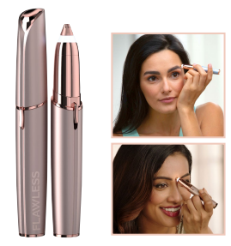

Brows Rechargeable £2.79
Product
SKU Code | 506595
EAN | 5010724536377
SKU Description | FLAWLESS BROW RECHARGEABLE BLUSH 3.0 DE
RRP | £19.99
Stock Volume | 16453
Stock Location | CPL / Germany
Logistic Info
Trade Unit | 6 pcs. per Carton
Weight Trade Unit | 1.200 g
Size Trade Unit | L 300 X B 110 X H 234 mm

Slide 3



Cleanse (£5.25)
Product
SKU Code | 507262
EAN | 5010724538180
SKU Description | FLAWLESS CLEANSE DE
RRP | £40.00
Stock Volume | 12445
Stock Location | CPL / Germany
Logistic Info
Trade Unit | 12 pcs. per Carton
Weight Trade Unit | 4.950 g
Size Trade Unit | L 480 X B 270 X H 260 mm

Slide 4

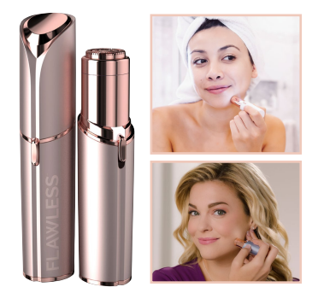

Face Rechargeable (£2.85)
Product
SKU Code | 506892
EAN | 5010724537220
SKU Description | FLAWLESS FACE BLUSH RECHARGE DE 3.0
RRP | £30.00
Stock Volume | 17014
Stock Location | CPL / Germany
Logistic Info
Trade Unit | 6 pcs. per Carton
Weight Trade Unit | 1.200 g
Size Trade Unit | L 300 X B 110 X H 234 mm

Slide 5
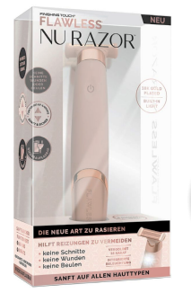
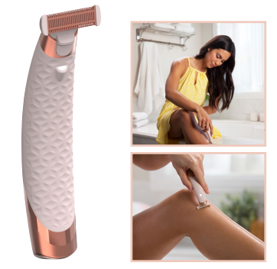

Nu Razor (£6.25)
Product
SKU Code | 506905
EAN | 5010724537299
SKU Description | FLAWLESS NU RAZOR DE
RRP | £40.00
Stock Volume | 23032
Stock Location | CPL / Germany
Logistic Info
Trade Unit | 12 pcs. per Carton
Weight Trade Unit | 3.900 g
Size Trade Unit | L 565 X B 233 X H 257 mm

Slide 6
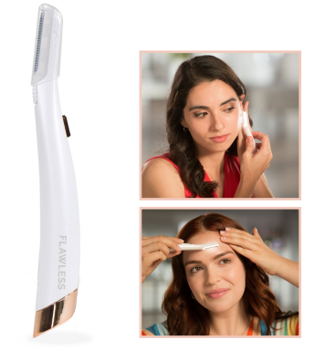


Dermaplane Glow (£2.85)
Product
SKU Code | 506399
EAN | 5010724535486
SKU Description | FLAWLESS FT GLOW INKL ERSATZKLINGEN 6 ST
RRP | £19.99
Stock Volume | 25938
Stock Location | CPL / Germany
Logistic Info
Trade Unit | 6 pcs. per Carton
Weight Trade Unit | 1.200 g
Size Trade Unit | L 305 X B 132 X H 235 mm

Slide 7
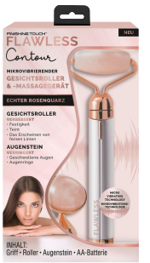
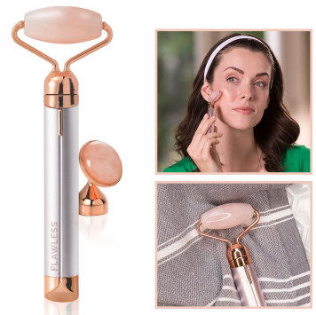

Contour (£3.49)
Product
SKU Code | 506374
EAN | 5010724535509
SKU Description | FINISHING TOUCH FLAWLESS CONTOUR DE
RRP | £19.99
Stock Volume | 19714
Stock Location | CPL / Germany
Logistic Info
Trade Unit | 6 pcs. per Carton
Weight Trade Unit | 1.660 g
Size Trade Unit | L 290 X B 130 X H 230 mm

